Slide 1
Cs-381 Software Engineering
Course Instructor: Dr. Shazia Arshad
Notes:
Welcome to all of you in this course. I am Dr. Shazia Arshad. I will be your instructor for this course.

Slide 2
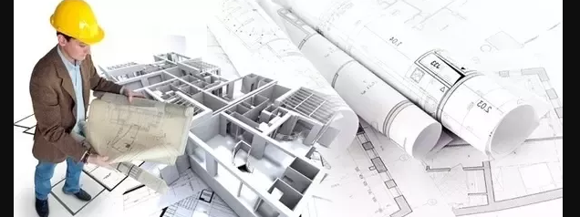
What is Architecture??
Notes:
Before starting, lets start with the definition of architecture.
By word of architecture, most people think it is to BUILD BUILDINGS ONLY.
Is the meaning of architecture is CONFINED to building buildings only??
What do you think the architecture is??
Architecture is no matter which field it is, are that interface between the customer, what they want, and the contractor, the implementer, the person building the thing.
The study of architecture is always oriented towards two poles:
Towards seeing objects for the purpose of creation.
Towards creating objects for the purpose of seeing.
Let’s discuss the job of artist and architect.
While artists work from real to the abstract, architects must work from the abstract to the real.

Slide 3
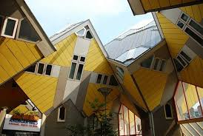
Architectural Design
Notes:
Begins with a question of What the distinction between artist and architect?
While artists work from real to the abstract, architects must work from the abstract to the real.
The job of artist is to observe the REAL things and transform them into their design. As opposite to this, the architects works on their imagination and transform them into real world objects.
Can a BAD architectural design be rescued by Good Design?
No, a bad architectural design can't be rescued by good construction.
How architects actually work?
Do architects follow the same design principles for each project??
Can building a skyscraper, a dam, a nuclear reactor the same thing??
Well No, there are specialist types of projects that require certain architect expertise.
Does the architecture or design is attributed to a specific architect??
Is designing buildings or complex structures the effort of only one architect??

Slide 4
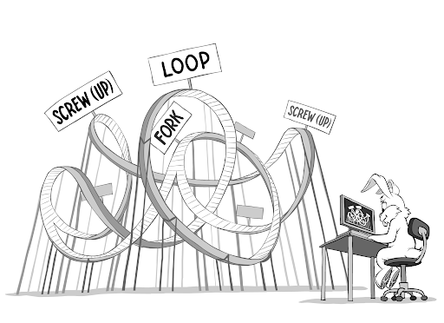
SOFTWARE ARCHITECTURE
Notes:
So what is actually software architecture?
It is the "structure of the components of a program/system, their relationships, and principles and guidelines governing their design and evolution over time".
"The software architecture of a program or a computing system is the structure or structures of the system, which comprise software elements, the externally visible properties of those elements, and the relationship among them."
"Software architecture is the fundamental organization of the system, embodied in its components, their relationship to one another and the environment, and the principles governing its design and evolution."
All of these definitions have some common points like components and the relationship among components.
“Software architecture is primarily concerned with partitioning of large systems into smaller ones that can be created separately, that individually have business value, and that can be straightforwardly integrated with one another and with the existing systems.”
All of previous definitions have some common points like partitioning components and the relationship among components.

Slide 5
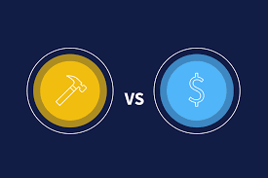
Buy / BUild
Notes:
Where does the software architecture plays its role?
From the last slide, we have seen that software architecture involves portioning of the key components. Now, let’s take a look that why this partitioning is important?
Now there's several reasons why this partitioning is a key component?
What do you prefer when it comes to develop a new software?? How you have completed your previous semester projects??
Build it yourself
Buy it from market
One of the things that we talk about in terms of software architecture is a Decision for example, buy versus build?
That's where the architecture comes in:
Take the entire large system and partitioning it into smaller ones that may or may not be individually built by your team. Or contracted out for build by someone else.

Slide 6

Well architecture
Example:
WORLD WIDE WEB
Notes:
Lets define the importance of good architecture.
Why it is necessary to have good architectural design?
Example:
World Wide Web-->> decentralized and client server architecture.
A lot of success of large-scale systems deals with making sure that the architecture is good.
Mistakes in an architectural design at large scale level is very difficult to cover up.
Example:
Consider the case that you are building a dam. During its construction, you have found mistakes in an architecture. Now, you have to deconstruct, demolish the whole thing and start over. That may very well be true for your entire software system too, and that's something that most companies just can't solve.
What makes good software architecture?
A good Software Architecture is the result of good Leadership by a good Architect.
There is no universal standard on good or bad.
Here are some of the principles on defining good software architecture:
Accountable: good software architecture makes each team hold accountability for its corresponding business objective
Autonomous: good software architecture should allow each team to move on largely independently without being blocked by others too frequently
Amortized: good software architecture promote forward thinking, allows the upfront cost of infrastructure amortized.

Slide 7

Architectural Challenges
Notes:
Its s time to discuss the challenges, a software architect have to face.
Achieving Parallelization: (Who and what team are going to work on, project-manage, develop and test individual still potentially large sets of software.)
Funding:
Including, where are we going to get the money,
the budget to pay for the developers, the project managers, the designers, the testers and beta testing, user testing, acceptance testing,
to make sure that this project is a success.

Slide 8
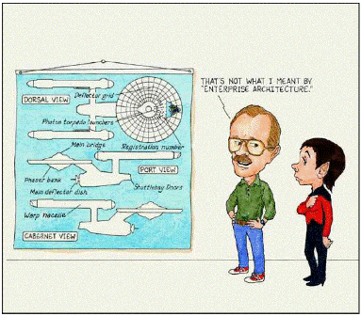
Architectural Models
Notes:
Ever wondered how large enterprise scale systems are designed?
Before major software development starts, we must choose a suitable architecture that will provide us with the desired functionality and quality attributes. Hence, we should understand different architectures, before applying them to our design.
Example:
Just like before constructing a house, an architect follows several different plans and selects a one that suits his requirements e.g. the one that is best from available resources perspective, similarly, a software architect also take into account different architectural styles or models for his application.
What do we mean by Architectural Pattern?
An architectural pattern is a general, reusable solution to a commonly occurring problem in software architecture within a given context.

Slide 9
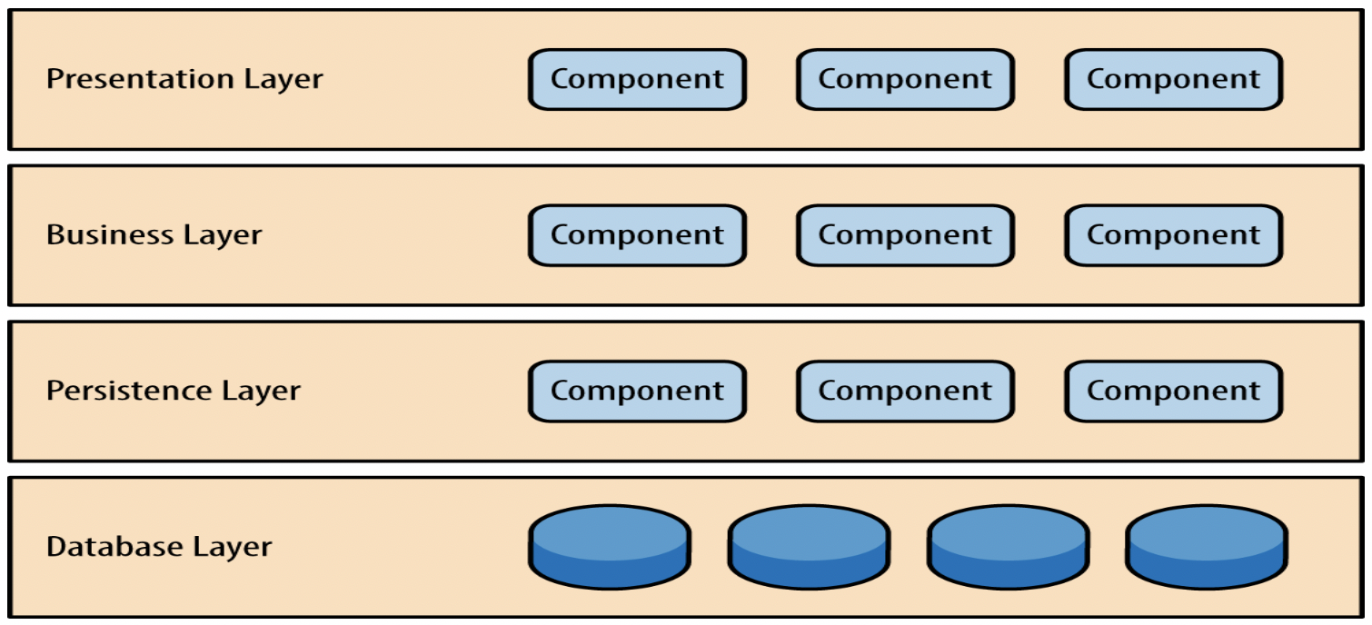
Layered Architecture
Notes:
Also known as the n-tier architecture pattern.
This is the traditional method of designing applications.
Layered architecture patterns are n-tiered patterns where the components are organized in horizontal layers.
This pattern can be used to structure programs that can be decomposed into groups of subtasks.
Each layer provides services to the next higher layer and is self-independent.
The code is arranged so the data enters the top layer and works its way down each layer until it reaches the bottom, which is usually a database
The layered architecture pattern does not specify the number and types of layers:
The presentation layer: It contains all categories related to the presentation layer (e.g. would be responsible for handling all user interface, it only needs to display that information on a screen in particular format. Uses HTML, CSS, Bootstrap and from-end developing techniques.)
The business layer: It contains business logic (e.g. perform business logic against the data (e.g., calculate values or aggregate data))
The persistence layer: It’s used for handling functions like object-relational mapping. (e.g. 1:1 mapping)
The database layer: This is where all the data is stored, e.g. database.
Advantages:
Maintainable
Testable
Easy to assign separate "roles"
Easy to update and enhance layers separately
How the layers are independent?
Thus if, for example, we want to change the database from an Oracle server to a SQL server, this will cause a big impact on the database layer but that won’t impact any other layers.
Usage
New applications that need to be built quickly
Enterprise or business applications that need to mirror traditional IT departments and processes
Teams with inexperienced developers who don’t understand other architectures yet
Applications requiring strict maintainability and testability standards
General desktop applications.
E commerce web applications.
Cons:
Although changes can be done to a particular layer, it is not easy because the application is a singular unit. This also makes it difficult to scale.
It must be deployed as a singular unit thus a change to a particular layer means the whole system must be redeployed.
The larger is it, the more resources it requires for requests to go through multiple layers and thus will cause performance issues.

Slide 10
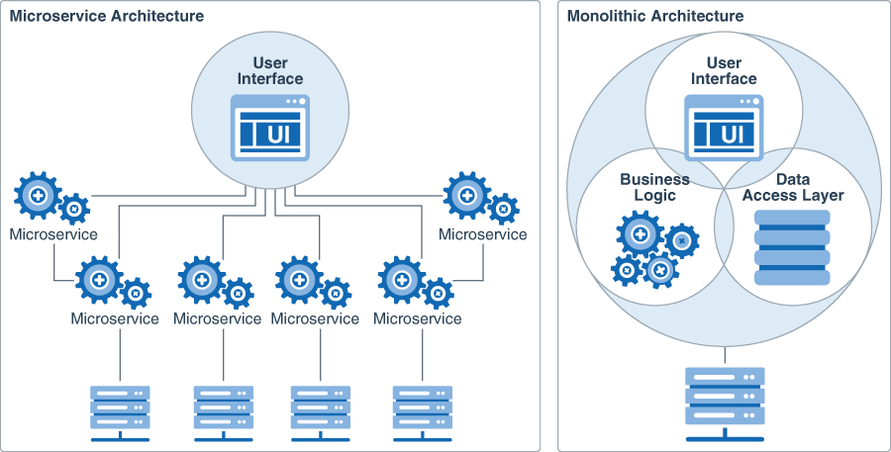
MICROSERVICES Architecture
Notes:
The traditional way of building applications is by using MONOLITHIC architecture.
A monolithic application is built as a single and indivisible unit.
It is unified and all the functions are managed and served in one place.
Here are few limitations of using MONOLITHIC architecture just like:
Complex: It is harder to implement changes in such a large and complex application. Any code change affects the whole system, so it must be thoroughly coordinated. This makes the overall development process much longer.
Scalability. You cannot scale components independently, only the whole application.
New technology barriers. It is extremely problematic to apply a new technology in a monolithic application because then the entire application has to be rewritten.
Microservice architecture is designed to overcome the challenges, failure, and breakdown of larger applications.
What is microservice architecture?
Microservice architecture divides the application into smaller chunks.
A microservices architecture breaks it down into a collection of smaller independent units.
These units carry out every application process as a separate service. So, all the services have their own logic and the database as well as perform the specific functions.
The entire functionality is split up into independently deployable modules which communicate with each other through defined methods called APIs (Application Programming Interfaces).
Each service covers its own scope and can be updated, deployed, and scaled independently.
Microservices are designed around business capabilities, not horizontal layers such as data access or messaging.
Benefits / Pros of Microservice Architecture:
Easier understanding. Split up into smaller and simpler components, a microservice application is easier to understand and manage. You just concentrate on a specific service that is related to a business goal you have.
Better scalability. Another advantage of the microservices approach is that each element can be scaled independently. So, the entire process is more cost- and time-effective than with monoliths when the whole application has to be scaled even if there is no need in it.
Independent components. Firstly, all the services can be deployed and updated independently, which gives more flexibility. Secondly, a bug in one microservice has an impact only on a particular service and does not influence the entire application.
Limitations / Cons of Microservice Architecture:
Testing. A multitude of independently deployable components makes testing a microservices-based solution much harder.
System distribution. A microservices architecture is a complex system of multiple modules and databases so all the connections have to be handled carefully.
Examples of Microservice Architecture:
UBER started its journey with monolithic architecture built for the single offering in a single city. As it was operated in only one city, one codebase option seemed to be the clean option and solve all the business problems. But, when it rapidly expanded to other cities, the system becomes difficult to handle. So, the whole architecture was changed and turned into microservice architecture.
Other examples include NETFILX, AMAZON, TWITTER, PAYPAL.

Slide 11

TIME TO THINK
What do you think will be the role of software architect????
Notes:
So, its time to check if you are active or not???
What do you think will be the role of software architect????

Slide 12

Time tO Answer
Notes:
A Software Architect’s duties and responsibilities will vary from project to project and company to company. There are, however, several common primary duties for nearly all Software Architects.
Develop Software Solutions: Their jobs often begin by working with a client to discuss what they need their custom software to do or looking at poor-behaving software and finding ways to improve it. Software Architects must conduct research, gather information, interpret data, and then create a solution.
Lead Project: . This may include creating a team of workers suitable for the scope of the project, assigning duties to the staff, creating a timeline for the project, and performing cost analysis and budgeting functions.
Document Projects: Documentation is a very important part of the Software Architect’s job. Every aspect of a system or application must be thoroughly recorded. These documents will serve as references for new employees and for future maintenance on the system.

